Slide 1
Hermes Microvision, Inc. Presents
HMI Status Update
December, 2016

Slide 2
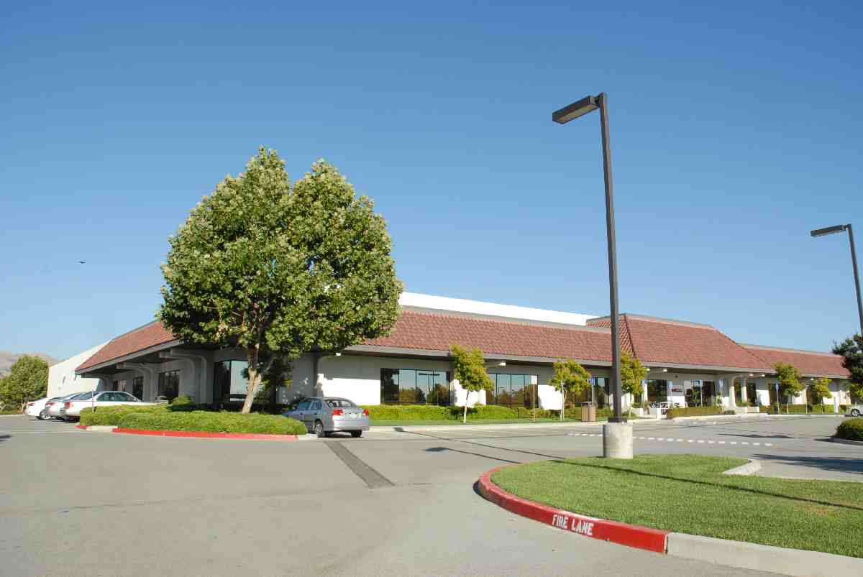
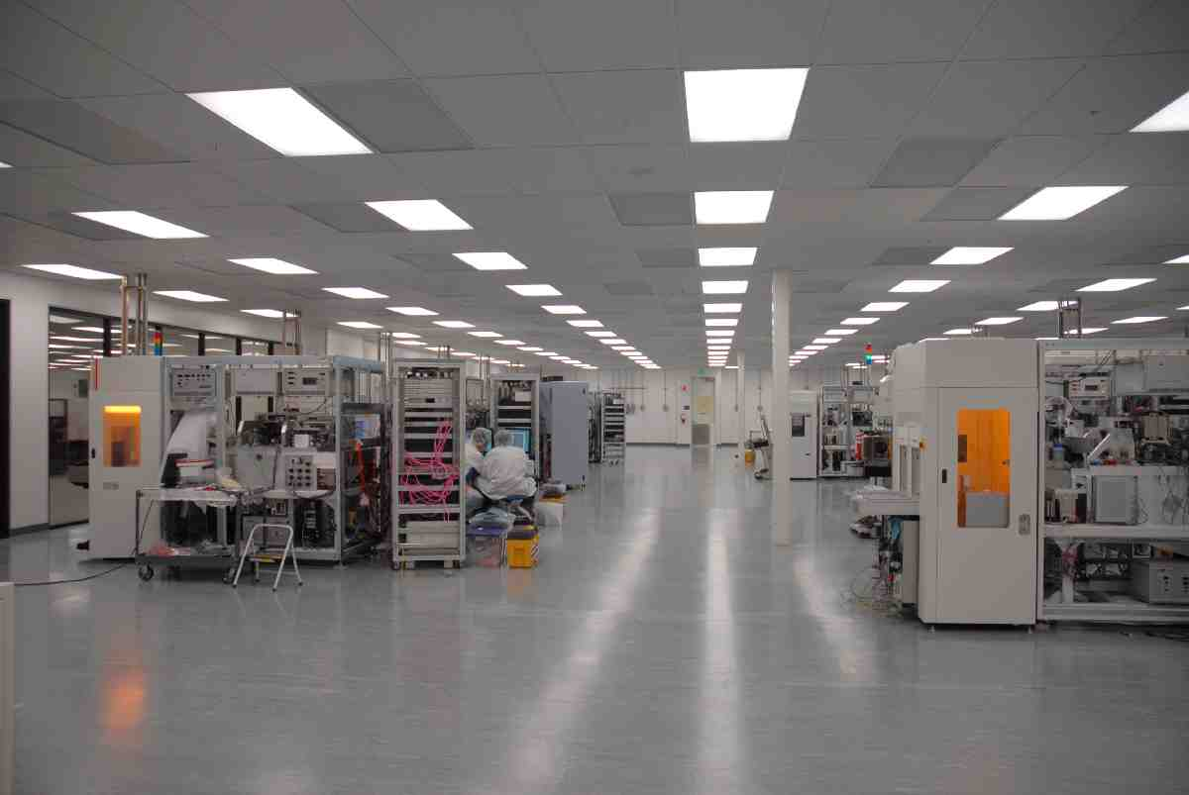
Hermes Microvison, Inc.
HMI founded in June 1998 at silicon valley and financed by Hermes-Epitek Corp
Technology Development Center in San Jose, California
Manufacturing facility in Taiwan’s Science Park
Worldwide sales and support offices in US, Japan, Korea, Taiwan
China, Singapore, Germany
San Jose Technology Center Demo and RD Lab

Slide 3
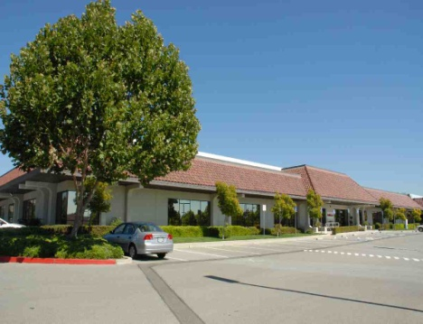
HMI Organization Structure
HMI Operation
HMI Technical Center
HMI Operation Center
at San Jose
at Taiwan
Research and Development
Material
Design----Design release documentation
Assy / Test
Sales / Agent Management
Hardware
Service Support
Software
Customer Training
Application
Parts Depot
CIP
Technical escalation level I
Technical escalation Level II
Documentation for Customer
Product and Technical Marketing
Local Marketing coordination
Demo / Live Demo
Demo / Live Demo
Pilot Production, Manufacturing Backup
Component Manufacturing

Slide 4
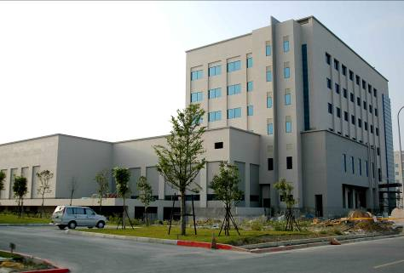
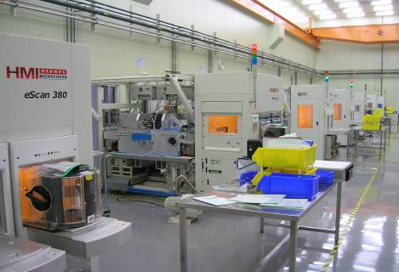
Hermes Microvision, Inc. (Taiwan)
HMI achieved ISO quality certification in Dec 2006
Technology development and demo center in San Jose, California
Worldwide sales and support offices in US, Japan, Korea, Taiwan, China, Singapore and Germany
New Facility was groundbreaking in June 2013. Shall ready for production in Q4 2014 to triple the production capacity for strong demand on EBI market.
Taiwan Tainan MFG Center
Manufacturing Floor

Slide 5
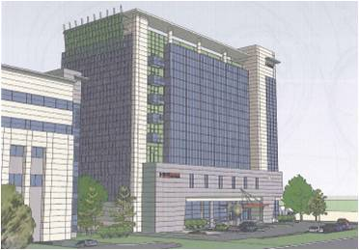
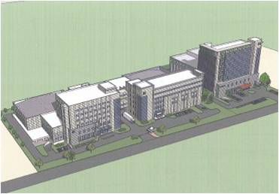
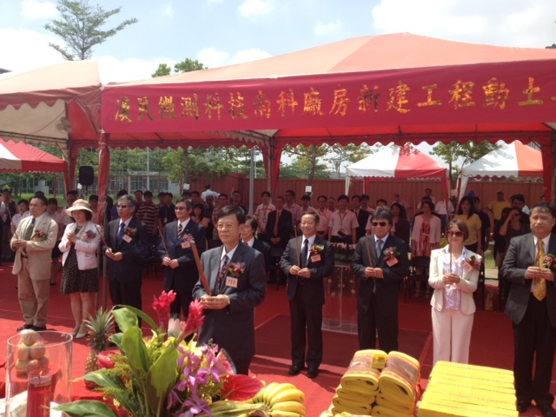
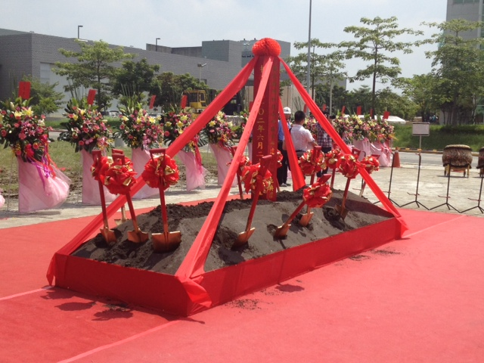
Expand Manufacturing Facility in Tainan

Slide 6
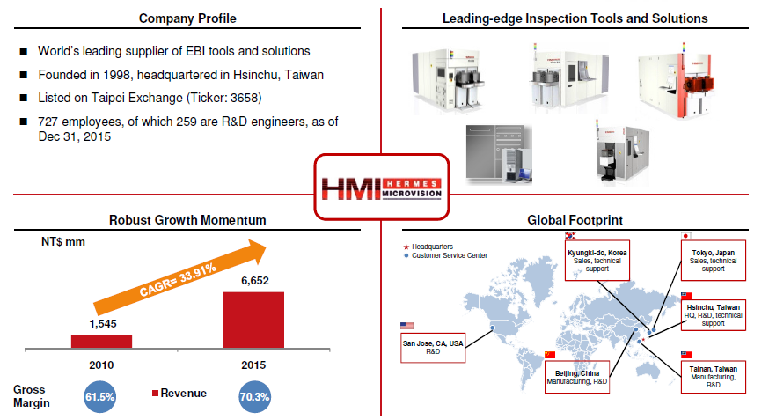
HMI Highlights

Slide 7
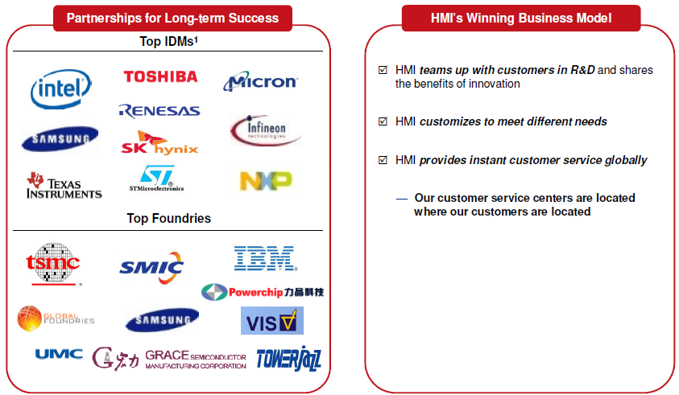
Strong Partnerships with Industry Leaders Based on Technology and Services

Slide 8
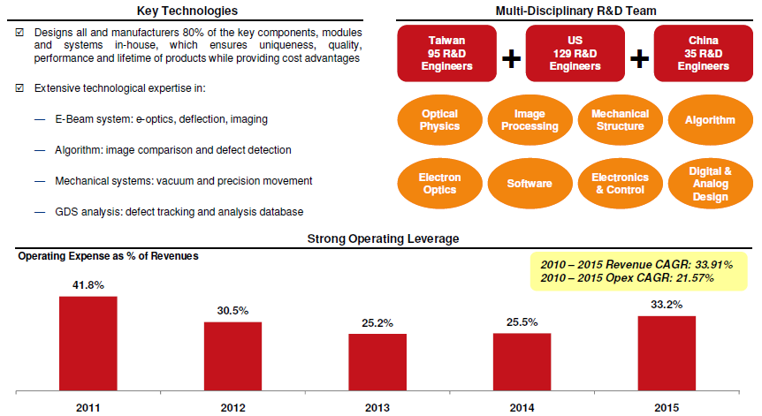
Integrated Business Model Delivering Superior Operating Efficiency

Slide 9
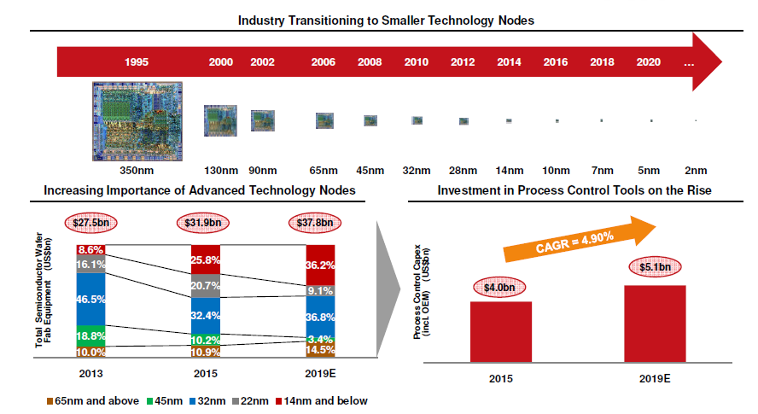
Clear Beneficiary of Fast Growing Semiconductor Process Control Segment

Slide 10
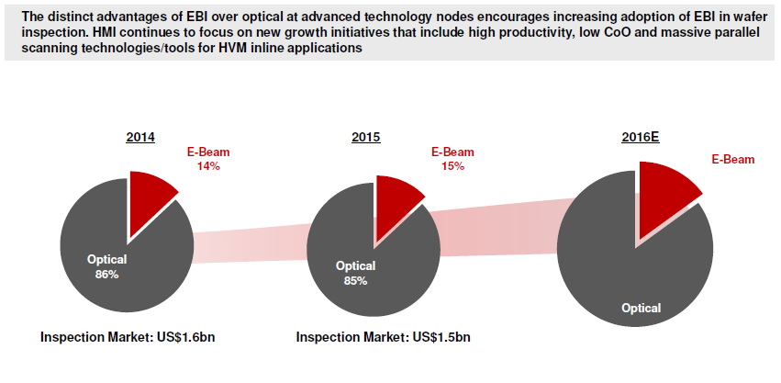
Clear Beneficiary of Fast Growing Semiconductor Process Control Segment

Slide 11
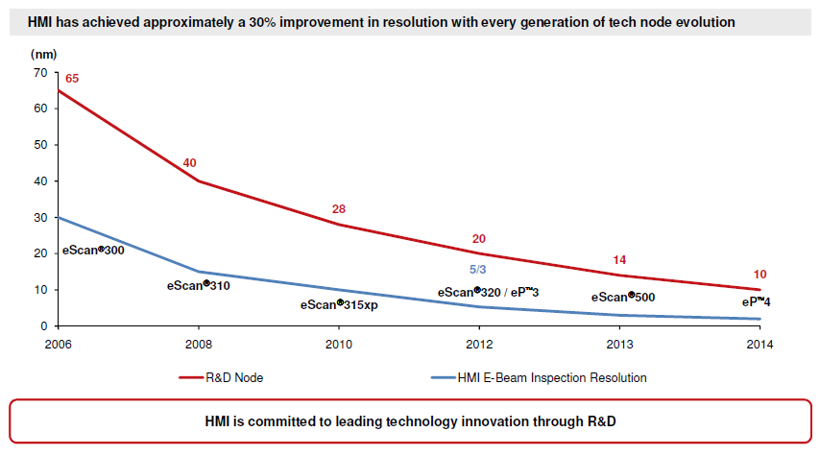
Leading Expertise in E-Beam Inspection Technology

Slide 12
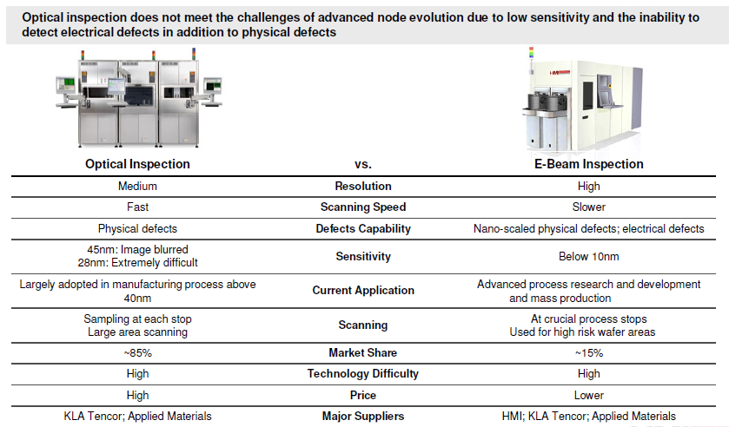
E-Beam Meeting the Challenges of Technology Advancement

Slide 13
Strong Growth Profile till 2013 Q1
HMI Growth profile among semi peers
Stands Out Among International Peers
Revenue
1Q12-1Q13 Revenue Growth
09-’12 Revenue
CAGR: 47%
33% YoY
Source: Annual Report;; Convenience translation of NTDUSD Ex Rate= 29.

Slide 14
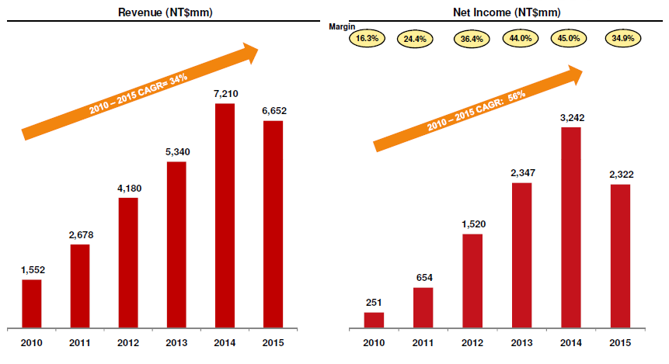
Robust Revenue Momentum and Profitability

Slide 15
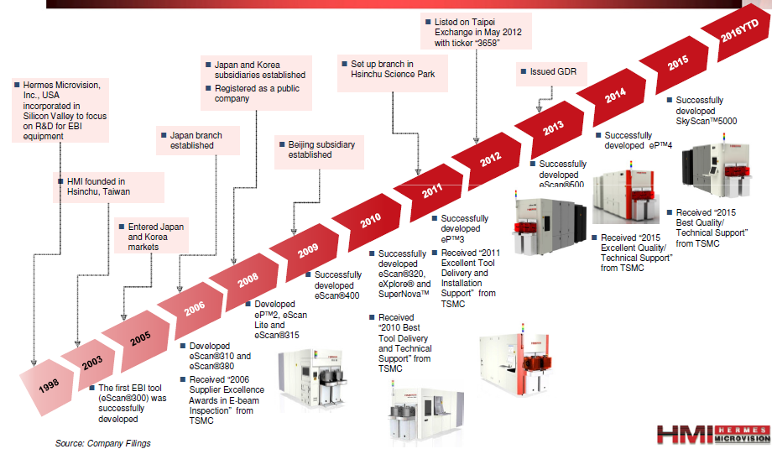
History and Key Milestones

Slide 16
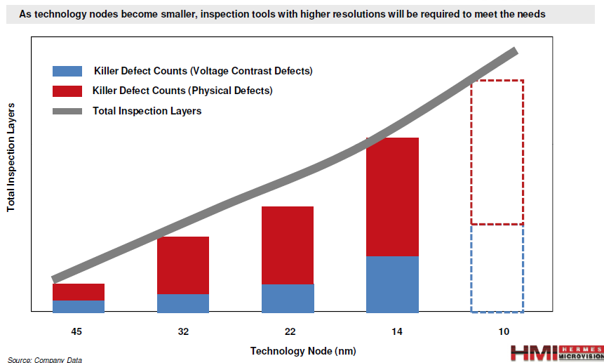
Advanced Geometries and Complex Processes Require Enhanced Precision for Yield Improvement

Slide 17
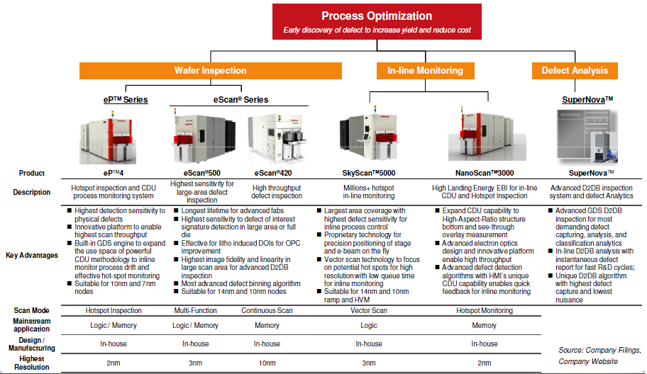
Overview of HMI’s Product Portfolio – Diversified Product Offerings and Capabilities

Slide 18
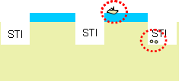
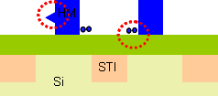
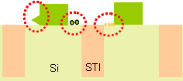
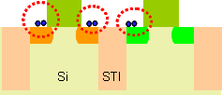
eScan Advanced Logic Ebeam Applications
2Xnm HKMG unique applications
Layer | DOI | Structure | Comments
Wet nitride strip | Residues, stringers |  | High resolution of < 10nm small pixel size
Poly hard-mask etch | Stringers, residues, and bridges |  | High-resolution of 10nm small pixel size with extraction
Poly gate etch | Oxide residue, pattern abnormal, active area damages, tiny residues, stringers |  | High resolution of small pixel size ( < 15nm )
LDD implant | Photo-resist residue after NMOS and PMOS PR strip |  | High-resolution of small pixel size ( < 10nm)

Slide 19
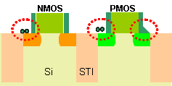
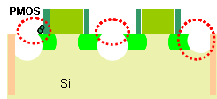
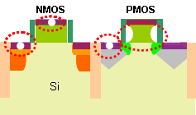
eScan Advanced Logic Ebeam Applications
2Xnm HKMG unique applications
Layer | DOI | Structure | Comments
Offset spacer/ spacer etch | Stringers, residues, pattern abnormal |  | Tiny stringers and residues may caused missing implants later due to micro-masking
SiGe recess after etch | Epi-edges’ extrusions, Residues, Pattern abnormal |  | High-resolution of small pixel size (< 10nm)
SiGe cap removal ( after SiGe growth ) | Bridging, Epi edges’ shape change (extrusions), residues, SiGe missing |  | High-resolution of small pixel size (< 10nm) with extraction
NiSix anneal and removal | NiSix missing/ poor formation on NMOS and PMOS active areas, gate open, missing gates, TiN missing |  | High-resolution small pixel size ( < 15nm ) with extraction
PMOS
Si

Slide 20
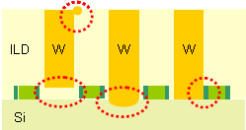
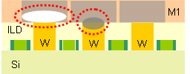
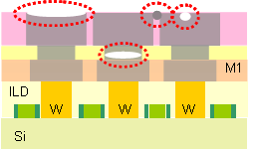
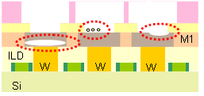
eScan Advanced Logic Ebeam Applications
2Xnm MEOL and BEOL unique applications
Layer | DOI | Structure | Comments
Contact WCMP | NMOS and PMOS Opens and leakages/ shorts, Contact-to-poly shorts, W residues, ILD voids |  | Advanced charge control is crucial
Metal 1 CMP | Opens and shorts |  | Traditional Ebeam layer
Metal_{X} CMP | Metal lines broken/ bridging, via open, voids on metal islands |  | High resolution of small pixel size ( < 15nm )
Metal trench | Cu loss, opens and residues |  | High resolution of small pixel size ( < 15nm ) with strong extraction

Slide 21
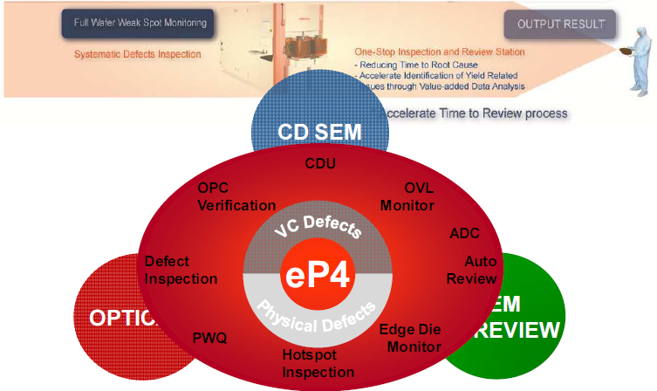
HMI Ebeam Applications
HMI

Slide 22
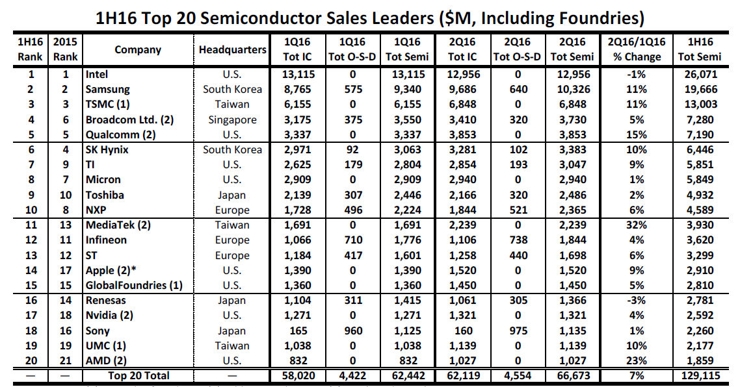
Who is our customer

Slide 23
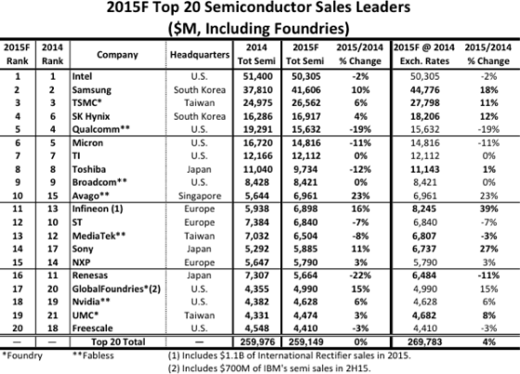
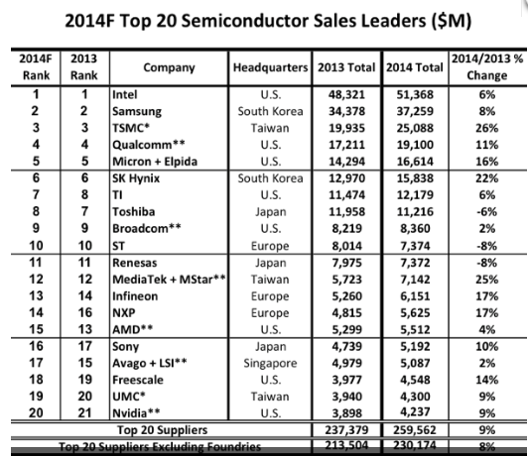
Who is our customer

Slide 24
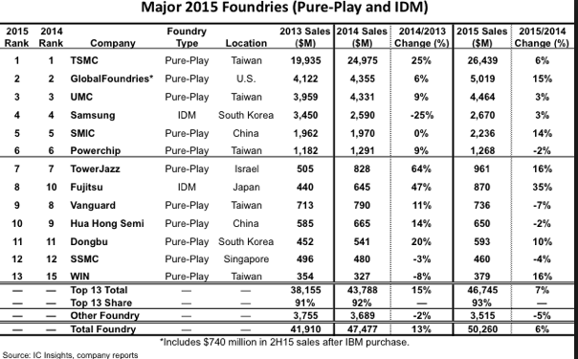
Who is our customer – Foundry – Physical Defects

Slide 25
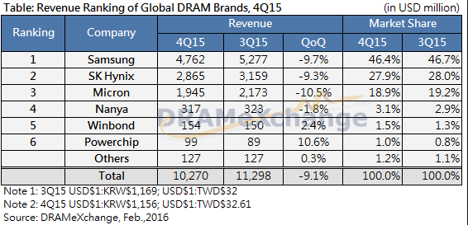
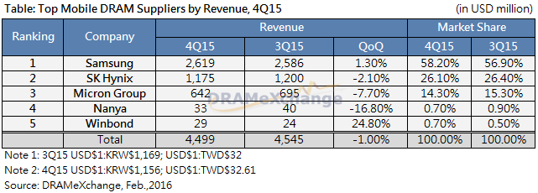
Who is our customer – DRAM – VC Defects

Slide 26
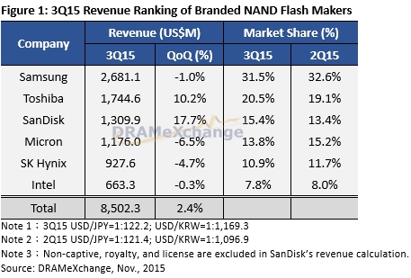
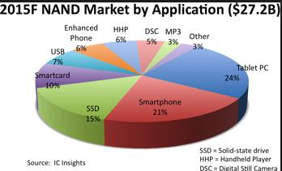
Who is our customer -- Flash

Slide 27
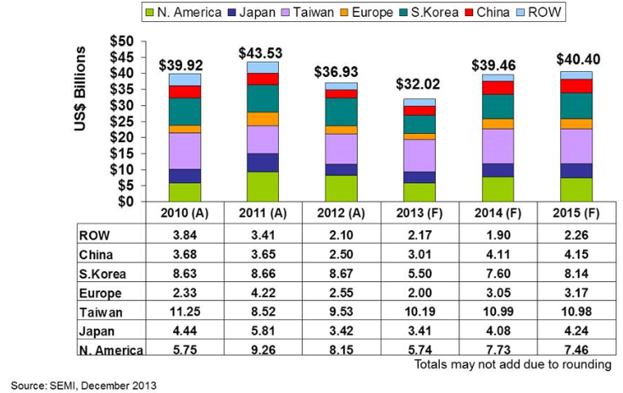
Who is our customer

Slide 28
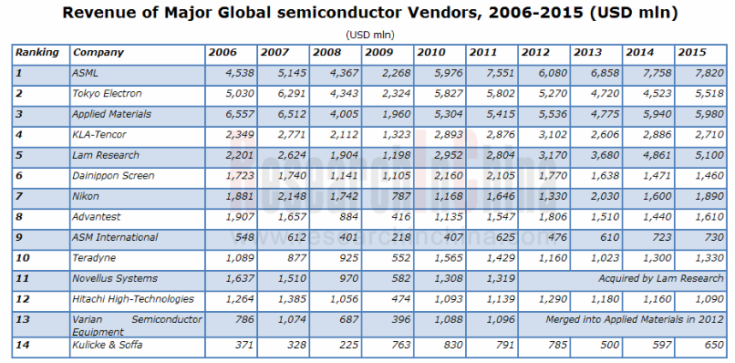
Who is our customer (Cont.)

Slide 29
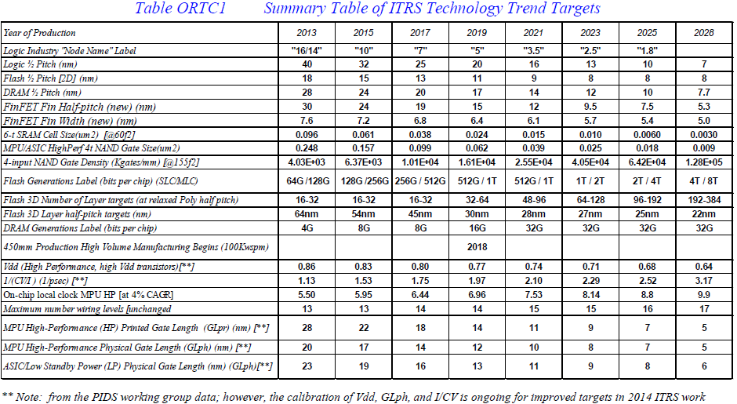
Roadmap of the Semiconductor Technology Trend

Slide 30
What is SEM and HMI EBI system

Slide 31
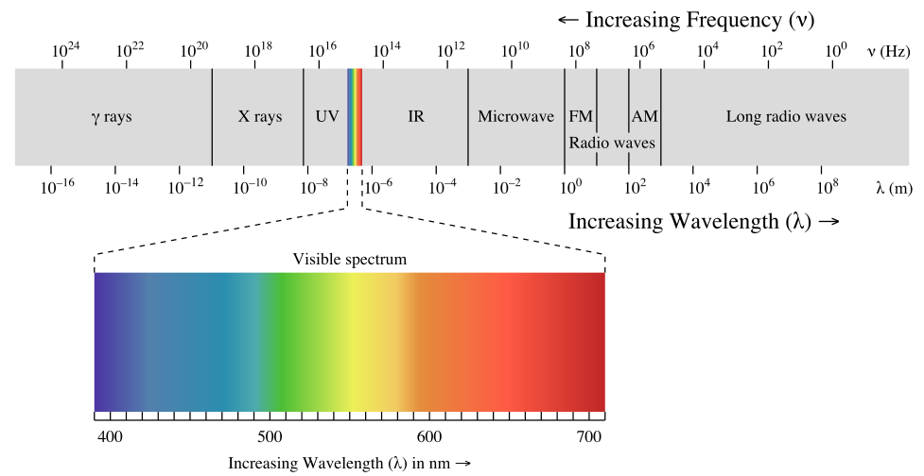
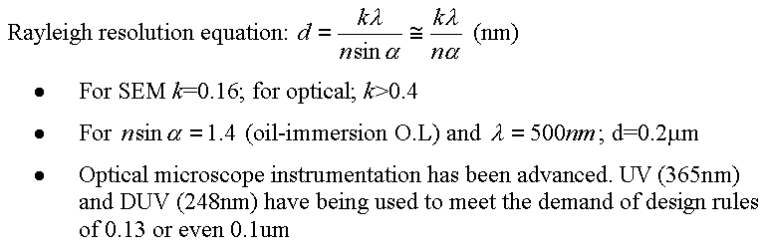
Resolution limitation

Slide 32
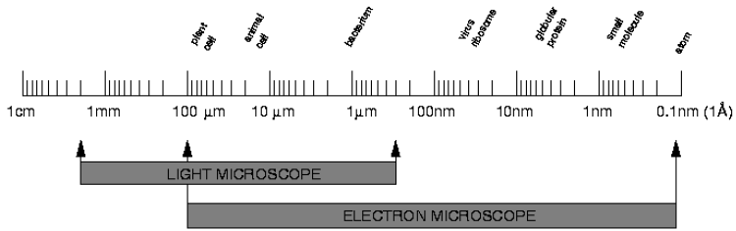
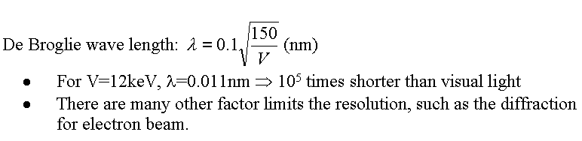
Inspection revolution
globular protein
Virus ribosome
Small molecule
Animal cell
bacterium
Plant cell
Atom

Slide 33
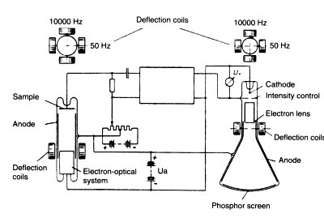
1st SEM designing schematic (Von Ardenne)
Von Ardenne
1940~41, RCA, USA; the first transmission electron microscope.
(Resolution 50 nm)

Slide 34





How does SEM work?
Ref: http://en.wikipedia.org/wiki/Scanning_electron_microscope
Filament emits beam of electrons
Anode accelerates electrons
C.L collimates the beam
O.L focuses beam onto specimen
Deflectors raster scan the focused beam over specimen
Detectors signals excited from specimen
Display system synchronizes signal with scan position to form image.
Types of Signals:
BSE=backscattered electrons SE=Secondary electrons
SC=specimen current
EBIC=e-beam induced current,
X=x-rays
Filament (electron emitter)
Electron extractor
Electron beam
Anode
Condenser lens
Y-scan
Y-scan signal
Scanning magnets
X-scan signal
X-scan
CRT
signal
Objective lens
Specimen
Detector
Stage

Slide 35
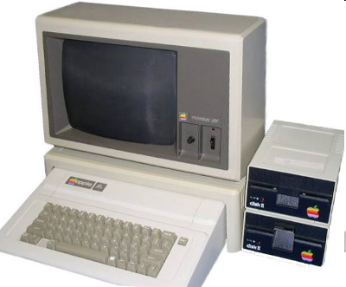
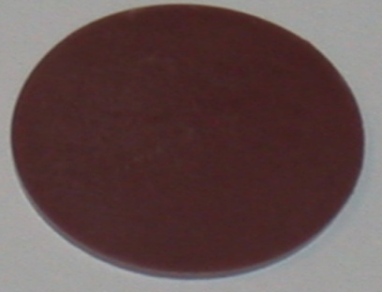
How do we get an SEM image?
Electron gun
156 electrons!
228 electrons!
Detector
Deflector
Image

Slide 36

Interaction Volume
Low acceleration Voltage
High acceleration Voltage
Low atomic number
High atomic number
Diffusion of incident electrons (after Duncumb and Schields)

Slide 37
Landing Energy vs. SEM image
Lower LE: Clear Surface information
Higher LE: More material contrast

Slide 38

Interaction Volume

Slide 39

Energy spectrum of the electrons emitted from a specimen
Incoming electrons
Secondary electrons
Auger electrons
Backscattered
electrons
Cathodo-
luminescence (light)
X-rays
Sample

Slide 40



BSE vs. SE
Fig. STI patterns at (a) SE mode with low landing energy (b) SE mode at high landing energy; (c) BSE at high landing energy;

Slide 41
VC Theory and Application

Slide 42




P-N Type Semiconductor
Dope P or Sb to get extra electron → Donor
N Type Semiconductor
P Type Semiconductor
Dope B get extra hole → Acceptor

Slide 43


P-N Junction
Equilibrium Bias

Slide 44



Forward and Reverse Bias

Slide 45

Forward \ Reverse Bias vs. SE Energy
IV curve btw Forward and Reverse Bias
Energy spectrum
SE energy <50ev; 90% of SE less than 10eV and most from 2eV to 5eV. So, partial of the SE larger than Forward bias but smaller than Reverse bias.

Slide 46
Yield : LE/No.5 vs. Modes
σ (y)
or y (Yield) = Output/Input
1
Positive mode(Extracting): Yield >1
Negative mode (Retarding): Yield <1
LE
E₁
E
E₂
Negative charge can be controlled by
Changing landing energy (LE>E₂ or LE<E₁)
Biasing No.5 electrode (<0)
Positive charge can be controlled by
Changing landing energy (E₁<LE<E₂)
Biasing No.5 electrode (>0)
+V (extraction)
-V (Retarding)
I
I
O
O
σ >1
σ <1

Slide 47
Bias theorem on MOS
PE
PE
Extraction Field (Positive Mode)
No5
Retarding Field (Negative Mode)
No5
N+
P+
N+
P+
P-well
STI
N-well
P-well
STI
N-well
P-sub
P-sub
Simplified CMOS structure for analysis
Simplified CMOS structure for analysis
Reverse Bias
Forward Bias
Forward Bias
Reverse Bias

Slide 48
VC theorem
NMOS
PMOS
No5
No5
PE
PE
Positive Mode
Oxide
N+
N+
N+
P+
P+
P+
P-well
Reverse Bias
N-well
Forward Bias
N-Short
P-Open
No5
No5
PE
PE
Negative Mode
N+
N+
N+
P+
P+
P+
P-well
Forward Bias
N-well
Reverse Bias
N-Open
P-Short

Slide 49
VC theorem – Positive / Negative modes
Positive Mode (Extraction)
LE<E2 at No.5>0
Contact is brighter than Oxide
Negative Mode (Retarding)
LE>E2 at Weak No5>0 or No.5<0
Contact is darker than Oxide
N+
Gate
P+
N+
Gate
P+

Slide 50


VC defects
Positive Mode, 800eV
Negative Mode, 2000eV
P+ Open
N+ Open
N+ Leak
P+ Leak

Slide 51
VC defects
Positive Mode -- 800eV
Negative Mode -- 2keV
Open = DVC
Open = BVC

Slide 52
Basic VC theory: WCMP Inspection
Positive Mode
Negative Mode
W
W

Slide 53
Voltage Contrast is one Powerful EBI Technology
Voltage Contrast (VC) defect inspection is becoming more important in R&D and Process Monitor for3D NAND
Memory hole process
Interconnection process
VC defect inspection rely on the potential difference build-up on surface, exerting electrical field to influence the trajectories of secondary electrons
Perfectly etched contacts could drain most electrons, i.e., no surface potential build-up
Totally opened contacts accumulate excess positive charge (positive mode) to inhibit returns of secondary electrons (Dark VC)
Substrate

Slide 54
Challenging VC Defect Inspection in 3D NAND
VC inspection for3D NAND is challenging for regular VC technology
Surface potential is difficult to build up → intensive pre-scan may be required, leading to huge overhead for VC inspection
Surface potential once built up may not be sustainable for inspection
Timing between pre-scan and VC inspection could be critical for most difficult VC defects
P-well
P-well

Slide 55




Timing Control is Critical for Challenging VC
Die-row pre-scan
(6 DVC)
Per-die Pre-scan
(120 DVC)
Proper time elapse (pre-scan/inspection) improves sensitivity 20x

Slide 56
Feature -- VC Booster™ Technology
VC BoosterTM technology utilizes new electron optics design
Enhance pre-scan effectiveness and greatly reduce overhead by decoupling SEM condition between pre-scan and inspection
Charge up to SATURATION
Charge up in SHORTER time
Advanced timing control between pre-scan and inspection;
Pre-Charging
Discharging on normal CT
Discharging on under etched CT
Inspection window enlarged
Pre-Charging
Inspection

Slide 57




Feature -- VC Booster™ Case Study
VC Booster™ reveal killer NOP defect non-visible by normal pre-scan
Non-visible/low in SNR with normal pre-scan
High SNR with VC Booster Scan

Slide 58



Feature -- ACC(Advanced Charging Control) can help defect detection
E-beam
ACC
ACC off
Nuisance
ACC on
Found DOI
ACC-on makes BVC(nuisance) almost all disappear and can see some DVC

Slide 59
ACC (Advanced Charging Control)
ACC OFF
ACC ON
Sensitivity of CT open
ACC | OFF | ON
Plug A N+ CT | Low | High
Plug B P+ CT | High | High
Plug C Gate CT | Low | High
ACC obtains better surface charging and enhances
CT open defects on N+ / P+ / Gate !
Notes:
ISSM 2003 Speaker Template Notes
This template should only be used for on-screen presentations. Using the other templates for on-screen or PC projected presentations may result colors that appear too dark when projected and an image area that does not fill the screen. Conversely, this template should not be used for 35mm slides as it is not set up to the correct aspect ratio for that application.
This template may also be used for overheads, with some modifications: Change the background to clear and text color to bright or dark colors for better visibility.

Slide 60
WW Experience on VNAND

Slide 61


WW experience – 3D_NAND structure
L3
L2
L1
L4

Slide 62









3D_NAND BKM Table- L1 (Most important key layer)
Stack | Company | Condition | Tool | Patch Image | Remark
Gen 1 | Customer A | 100_3000_6_1_32nm_64F_ACC | eP3 | - | ACC is key
Gen 2 | Customer A | 100_3000_6_0.5_40nm_64F_ACC 100_3000_6_0.5_40nm_4D32F_ACC | eP3 eScan40x |  | ACC is key
Gen 3 | Customer A | 100_3000_7_0.25_35nm_2D64F_ACC | eP3 | - | ACC is key
Gen 4 | Customer A | 100_3000_25_0.4_10nm_2D64F_ACC | eScan500 | - | ACC is key
Gen 2 | Customer B | 300_2500_5_3_40nm_1D1L1F_ACC | eScan40x |  | Charging control – PreScan * 2
Gen 1 | Customer C | Flood: 1000_100uA_speed 10mm_ 1mm 300_3000_1nA_15nm_2D64F_100MHz | eScan500 |  | Charging control - Flood
Gen 1 | Customer D | Negative flood: -18V, 100uA Inspection: 1000_-1500_5_5_55nm_4D_2048 | eScan400XP |  | Charging control - Flood
Gen 1 | Customer D | Positive PreScan: 500_2500_1_140_300nm_64F_512 Inspection: 500_2500_6_5_60nm_32F_2048 | eScan400XP |  | Charging control - PreScan

Slide 63




3D_NAND BKM Table – L2
Stack | Company | Condition | Tool | Patch Image | Remark
Gen 1 | Customer A | 500_2500_5_5_30nm_4D_ACC | eScan40x | -
Gen 2 | Customer A | 500_2500_4_4_20nm_4D 300_3000_4_30_50nm_4D | eP3 eScan40x | -
Gen 3 | Customer A | 500_2500_5_8_30nm_4D | eScan40x | -
Gen 2 | Customer B | 500_1000_3_75_40nm_1D1L1F_ACC | eScan40x |  | Charging control – PreScan
Gen 1 | Customer C | Flood: 1000_100uA_speed 10mm_ 1mm 300_3000_1nA_15nm_2D64F_100MHz | eScan500 |  | Charging control - Flood
Gen 1 | Customer D | 500eV_2500_4_30_70nm_2D | eScan400XP

Slide 64
WW 3D_NAND EBI monitor layers
Layer | DOI | Care area | Remark
EBI Application
Channel Hole Poly CMP | DVC not open | Cell area | Main monitor layer(VC)
Metal Contact | DVC not open | Cell and PB Area | VC
Metal Contact 2 | DVC not open | Cell and PB Area | VC
Metal | Physical cut, bridge, broken | Cell | Physical
Metal 0 | Physical cut, bridge, broken | PB Area | Physical
contacts to connect word lines with different depth | open or punch through | periphery | VC
group contacts to different word lines | bottom poly short | cell | Physical
Except VC defect, there are also many physical defects need monitoring

Slide 65
WW Experience on DRAM

Slide 66





DRAM — See Through / OVL application
Purpose | Image | Feature | Advantage for HMI tool
See through / OVL | . | High LE / IQE | Performance is close as competitor
See through / OVL |  | High LE / IQE | Performance is close as competitor
See through / OVL |  | High LE / IQE | Performance is close as competitor
See through / OVL |  | High LE / IQE | 20% TPT higher than competitor

Slide 67






DRAM — Others
Purpose | Image | Features | Advantage for HMI tool
Physical + CD |  | IQE | 4X TPT faster than competitor
Physical + CD |  |  | Performance is close as competitor
VC |  | ACC | Performance is close as competitor
VC |  | ACC | Performance is close as competitor
Physical |  | High Resolution | Performance is close as competitor

Slide 68


DRAM — See Through / OVL application (1)
Feature:
High LE
Image Quality Enhancement (IQE)
No IQE
IQE

Slide 69

DRAM — See Through / OVL application (2)
Measure overlay error between BL (current layer) and AA (-2 layer)
Overlay error = (Right AA – Left AA)/2
Schematic Drawing
SEM Image for Measurement
BL
WL
Right AA
Left AA
Left AA
Right AA
Notes:
High Sensitivity: 218HS/hr1148 5h16m
High Throughput: 428HS/hr1148 2h41m

Slide 70




DRAM — See Through / OVL application (2)
Left AA
Right AA
No IQE
IQE
Notes:
High Sensitivity: 218HS/hr1148 5h16m
High Throughput: 428HS/hr1148 2h41m

Slide 71







DRAM — See Through / OVL application (3)
 | HS | HT
Image Quality
Enhancement | With IQE | With IQE
High Sens. & High TPT Q-Plot
TPT (images/hr) | High Sens. : 1982 High TPT : 3735 (< 4000) | High Sens. : 1982 High TPT : 5636
13500_0_50_5_1nm_512
13500_0_50_5_1nm_512
16D16F
12D12F
16D16F
8D8F
Match
Match

Slide 72
Bottom-up for Recipe Setup

Slide 73
Bottom-up for Recipe Set Up
Wafer & Recipe Info
Topo Contrast
LE
Mat Contrast
Analyzing DOI
Current
VC
Pixel size
Testing Condition
Good resolution
Stable
Average
General requirements
uniform
No.5 biasing
DOI Imaging
On Device
Scan direction
On Dummies
Setup recipe & Test
Pre-scan
On Edge Dice
Tuning Condition
On DOI
Pre-Flood
Optimizing Insp
Threshold
Device status control
Sensitivity
Reviewing DOI
VC Balance
BGB
ADC/reporting
DBDB

Slide 74
Bottom-up for Recipe Set Up -- Wafer & Recipe Information
Wafer & Recipe Info
Topo Contrast
LE
Mat Contrast
Analyzing DOI
Current
VC
Pixel size
Testing Condition
Good resolution
Stable
Average
General Imaging
uniform
No.5 biasing
DOI Imaging
On Device
Scan direction
On Dummies
Setup recipe & Test
Pre-scan
On Edge Dice
Tuning Condition
On DOI
Pre-Flood
Optimizing Insp
Threshold
Device status control
Sensitivity
Reviewing DOI
VC Balance
BGB
ADC/reporting
DBDB

Slide 75
Bottom-up for Recipe Set Up -- Wafer & Recipe Information
Design rule, device, Layer, DOI and signature (if available) …
Top-layer info: layout, topographical info, material info, feature size, …
Sub-layer info: layout, dielectric material and connection
Schematics of cross-section, root cause of DOI
Recipe info: such like die origin, die size, reticle size, center die, edge exclusion, AOI, sampling plan, etc.
requirements: Pixel size, Throughput, Sensitivity, False Rate, R&R, ADC Accuracy/Purity, etc.
Others

Slide 76
Bottom-up for Recipe Set Up – DOI Analysis
Wafer & Recipe Info
Topo Contrast
LE
Mat Contrast
Analyzing DOI
Current
VC
Pixel size
Testing Condition
Good resolution
Stable
Average
General Imaging
uniform
No.5 biasing
DOI Imaging
On Device
Scan direction
On Dummies
Setup recipe & Test
Pre-scan
On Edge Dice
Tuning Condition
On DOI
Pre-Flood
Optimizing Insp
Threshold
Device status control
Sensitivity
Reviewing DOI
VC Balance
BGB
ADC/reporting
DBDB

Slide 77
Bottom-up for Recipe Set Up – DOI Analysis
Location DOI Type Image Type DOI Examples
Foreign particles, Process residues, bump, dent, Pattern/CD change, …
Physical
Topo Contrast
Mat Contrast
chemical mark, etch/CMP remain, growth/deposition/implant missing, …
Surface
Electrical
VC
Short/Bridge/Broken (conductive)…
Physical
Mat Contrast
void, missing, … (limited capability for EBI)
DOI
Buried
Electrical
VC
Gate/S/D Leak, CT short/open, residues, piping
Physical
Mat Contrast
Footing, pitting, residue
HAR
Electrical
VC
CT under/over etch, residue, piping

Slide 78

Bottom-up for Recipe Set Up – DOI: Surface Physical
General Guidelines
Extraction mode
Reasonable Ip and pixel size (Spot size matches Pixel size) for proper resolution
Location DOI Type Image Type
Physical
Topo Contrast
DOI
Mat Contrast
Surface
Electrical
VC

Slide 79

Bottom-up for Recipe Set Up – DOI: Surface Material Contrast
General Guidelines
Extraction mode
Positive Pre-flood or pre-scan to boost contrast differences
Lo-LE or Hi-LE for optimal contrast.
Reasonable Ip and pixel size (Spot size matches Pixel size) for proper resolution
Location DOI Type Image Type
Physical
Topo Contrast
DOI
Surface
Mat Contrast
Electrical
VC

Slide 80


Bottom-up for Recipe Set Up – DOI: Surface Voltage Contrast
General Guidelines
Positive mode or negative mode
Proper scan direction and/or average modes impose different charging rate, thus VC may differs
Proper charging rate against discharging rate is the key
Pre-scan or post scan may help VC enhancement or charging control
Location DOI Type Image Type
Physical
Topo Contrast
Mat Contrast
DOI
Surface
Electrical
VC

Slide 81
Bottom-up for Recipe Set Up – DOI: Buried Material Contrast
Guidelines
Higher LE, deeper Ip penertrate
BSE mode may required
Location DOI Type Image Type
Physical
Mat Contrast
DOI
Buried
(CMP/Cap)
Electrical
VC
1kEV
1.5kEV

Slide 82






Bottom-up for Recipe Set Up – DOI: Buried Voltage Contrast
Guidelines
Positive (+) mode: Extraction + Lo-LE; Positive flood/pre-scan helps
Negative (-) mode: Retarding or extraction + Hi-LE; negative flood/pre-scan helps
For WCMP,
(+) mode DOI: N+/Pwell leak, P+/Nwell Open; Gate Leak
(-) mode DOI: P+/Nwell leak, N+/Pwell Open; Gate Leak
For Caped CMP
(-) mode only, DOI Open&Leak,
Location DOI Type Image Type
Physical
Mat Contrast
DOI
Buried
(CMP/Cap)
Electrical
VC

Slide 83
Bottom-up for Recipe Set Up – DOI: HAR Material Contrast
Guidelines
Challenge layer for current EBI tool
High LE + Energy Filter may help
Location DOI Type Image Type
Physical
Mat Contrast
DOI
HAR
Electrical
VC

Slide 84




Bottom-up for Recipe Set Up – DOI: HAR Voltage Contrast
Location DOI Type Image Type
Guidelines
Normally extraction, retarding if VC reverse.
Normally Lo-LE, slightly Hi-LE if VC reverse.
Flood may enhance VC, must if VC reverse.
Physical
Mat Contrast
DOI
HAR
(w/o CMP)
Electrical
VC

Slide 85
Bottom-up for Recipe Set Up – Testing Condition
Wafer & Recipe Info
Topo Contrast
LE
Mat Contrast
Analyzing DOI
Current
VC
Pixel size
Testing Conditions
Good resolution
Stable
Average
General requirements
uniform
No.5 biasing
DOI check
On Device
Scan direction
On Dummies
Setup recipe & Test
Pre-scan
On Edge Dice
Tuning Condition
On DOI
Pre-Flood
Optimizing Insp
Threshold
Sensitivity
Reviewing DOI
VC Balance
BGB
ADC/reporting
DBDB

Slide 86
BKM for Fine Tune Optimal Condition

Slide 87
BKM Flow Chart – POR Recipe verification by Hot Recipe
Recipe capability verification and system monitor
Recipe verification
Wafer alignment
Care area
Global auto-focus point
Defect density setting
ADC knowledge
Start
Recipe optimization
POR Baseline Recipe
Hot recipe
Condition verification
Landing energy
No. 5 voltage
Probe current
Pixel size
Average
Select suitable wafer for monitor purpose
Delta GLV
Inspection defect count
Routine Recipe monitor
Charging control verification
Check baseline condition
Pre-scan
Flooding
Sensitivity > Baseline recipe?
Yes
No

Slide 88
Summary – Layer: B16AL21
BKM flow-chart for recipe optimization is verified through device B16A L21 layer
Final recipe conditions as shown in the table below based on CIP4 recipe
Target
Defect capture rate >90%, defect delta GLV >70% of high sensitivity mode
Follow-up actions
To verify the recipes on production lots via electrical wafer-maps signature and/ or FA
Item | Inspection step | LE | No. 5 voltage | Probe current | Pixel size | Averages
Original recipe | Pre-scan | 500 | 2500V | 1300nA | 130nm | 1D1L2F
 | Continue scan | 500 | 2500V | 7nA | 65nm | 1D1L8F
Production recipe (high throughput) | Pre-scan | 500 | 2500V | 1300nA | 130nm | 1D1L4F
 | Continue scan | 500 | 2500V | 7nA | 65nm | 1D1L8F
High Sensitivity | Continue scan | 200 | 2500V | 1nA | 32.5nm | 1D1L128F

Slide 89








Comparison Pre-scan average
Pixel size (nm) | 65 | 65 | 65 | 65 | 65
Pre-scan averages | 1F | 2F | 4F | 8F | 16F
Inspection averages | 8F | 8F | 8F | 8F | 8F
Defect count (CS mode) | 1 | 20 | 23 | 12 | 20
Defect count (High sensitivity) | 21 | 21 | 23 | 13 | 24
Defect capture rate (%) | 4.7 | 95.2 | 100 | 92.3 | 83.3
GLV (hole) | 110 | 51 | 50 | 88 | 104
GLV (background) | 212 | 209 | 212 | 214 | 200
Delta GLV | 102 | 158 | 162 | 126 | 96
Delta GLV Max (High Sensitivity) | 186 | 186 | 186 | 186 | 186
Delta GLV vs Delta GLV Max (%) | 54.8 | 84.9 | 87 | 67.7 | 51.6
Delta GLV vs Delta GLV Max (%)
Production setting
Target line
Pre-scan frame average
Capture rate (%)
Production setting
Target line
Pre-scan more than 4F will cause over charging and decrease defect signal
Pre-scan frame average
Reference (review image)

Slide 90




Comparison Landing Energy
Pixel size (nm) | 65 | 65 | 65
Landing Energy | 300 | 500 | 700
Pre-scan averages | 4F | 4F | 4F
Inspection averages | 8F | 8F | 8F
Defect count (CS mode) | 33 | 23 | 31
Defect count (High sensitivity) | 35 | 23 | 31
Defect capture rate (%) | 94.2 | 100 | 100
GLV (hole) | 62 | 50 | 48
GLV (background) | 209 | 212 | 203
Delta GLV | 147 | 162 | 155
Delta GLV Max (High Sensitivity) | 186 | 186 | 186
Delta GLV vs Delta GLV Max (%) | 79 | 87 | 83.3
Delta GLV vs Delta GLV Max (%)
Production setting
Target line
Landing Energy
Capture rate (%)
Production setting
Target line
Pre-scan frame average
Landing Energy
Reference (review image)

Slide 91





Comparison NO.5
Pixel size (nm) | 65 | 65 | 65 | 65
NO.5 | 0 | 2000 | 2500 | 3000
Pre-scan averages | 4F | 4F | 4F | 4F
Inspection averages | 8F | 8F | 8F | 8F
Defect count (CS mode) | 19 | 16 | 23 | 32
Defect count (High sensitivity) | 19 | 16 | 23 | 34
Defect capture rate (%) | 100 | 100 | 100 | 94.1
GLV (hole) | 89 | 40 | 50 | 78
GLV (background) | 196 | 179 | 212 | 199
Delta GLV | 107 | 139 | 162 | 121
Delta GLV Max (High Sensitivity) | 186 | 186 | 186 | 186
Delta GLV vs Delta GLV Max (%) | 57.5 | 74.7 | 87 | 65
Delta GLV vs Delta GLV Max (%)
Production setting
Target line
NO.5
Capture rate (%)
Production setting
Target line
NO.5
Reference (review image)

Slide 92




Comparison Inspection average
Pixel size (nm) | 65 | 65 | 65
Pre-scan averages | 4F | 4F | 4F
Inspection averages | 4F | 8F | 16F
Defect count (CS mode) | 19 | 23 | 18
Defect count (High sensitivity) | 19 | 23 | 18
Defect capture rate (%) | 100 | 100 | 100
GLV (hole) | 53 | 50 | 45
GLV (background) | 195 | 212 | 170
Delta GLV | 142 | 162 | 125
Delta GLV Max (High Sensitivity) | 186 | 186 | 186
Delta GLV vs Delta GLV Max (%) | 76.3 | 87 | 67.2
Delta GLV vs Delta GLV Max (%)
Production setting
Target line
Inspection frame average
Capture rate (%)
Production setting
Target line
Although inspect with 4F pass spec, its noise will cause hard to classify and maintain.
Inspection frame average
Reference (review image)

Slide 93




Comparison Inspection pixel size
Pixel size (nm) | 55 | 65 | 75
Pre-scan averages | 4F | 4F | 4F
Defect count (CS mode) | 12 | 23 | 10
Defect count (High sensitivity) | 12 | 23 | 14
Defect capture rate (%) | 100 | 100 | 71.4
GLV (hole) | 54 | 50 | 104
GLV (background) | 182 | 212 | 191
Delta GLV | 128 | 162 | 87
Delta GLV Max (High Sensitivity) | 186 | 186 | 186
Delta GLV vs Delta GLV Max (%) | 68.8 | 87 | 46.7
Delta GLV vs Delta GLV Max (%)
Production setting
Target line
Inspection pixel size
Capture rate (%)
Production setting
Target line
Inspection pixel size
Reference (review image)

Slide 94
Conclusion for layer of B16AL21
Production condition -- High Throughput with Prescan(4F) and Inspection(8F) could balance Sensitivity (S/N & Image Quality) and Throughput (Inspection time or Scan Rate).
Super high TPT condition -- With Prescan(2F) and Inspection(4F) also satisfied the request on both Capture Rate and Delta Graylevel.

Slide 95
Thank You !!

